Slide 2
OpenDiabetesVault: Data Gathering and Data Slicing Algorithms
Ankush Chikhale
21.09.2017

Slide 3
Content
Motivation for Thesis.

Slide 4
Why Data Gathering and Data Slicing Algorithms?
Researchers at TK have decided to undertake a project for analyzing medical data.
Analysing medical data, researchers at TK wish to generate patterns/ Trends.
Basic steps of Data mining/analysis is to have a big set of data.
Why big set of data? It will be handy to make more sense
In our case, we needed data from below few webistes
Crawler Carelink Website
Google Maps Timeline
Sony Fitness App
Data is in bulk amount and hence needs to be automated.
Most part of the Thesis is to automate/ease process of generating large amount of medical data from carelink website.
Later on this generated data will be cleanded before applying any machine learning algorithms on them.
Notes:
Researchers at TK wish to create a framework where in data from all different sources will come, and it will be cleanded up to the required fomat and then slicing algorithm will be applied on it, so that the quality of data is good and will in turn help to genrate more relevant patterns/trends.

Slide 5
Where do we get our data?
Especially in our case, Mr. Jens has chosen below three sources for gathering data
Crawler Carelink Website
Google Maps Timeline
Sony Fitness App
My task is to generate data from Carelink Website.
As visitng website each time and downloading each and every report/data would be tedious.
We thought of automating this process of downloading data from Carelink Website
This is the starting point of Implementation.
Notes:
Researchers at TK wish to create a framework where in data from all different sources will come, and it will be cleanded up to the required fomat and then slicing algorithm will be applied on it, so that the quality of data is good and will in turn help to genrate more relevant patterns/trends.

Slide 6
Especially in our case, Mr. Jens has chosen below three sources for gathering data
Crawler Carelink Website
Google Maps Timeline
Sony Fitness App
My task is to generate data from Carelink Website.
As visitng website each time and downloading each and every report/data would be tedious.
We thought of automating this process of downloading data from Carelink Website
This is the starting point of Implementation.
Notes:
Researchers at TK wish to create a framework where in data from all different sources will come, and it will be cleanded up to the required fomat and then slicing algorithm will be applied on it, so that the quality of data is good and will in turn help to genrate more relevant patterns/trends.

Slide 7

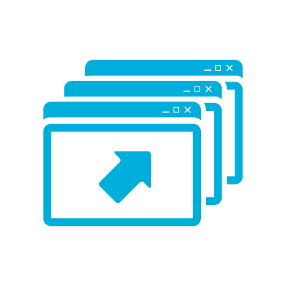


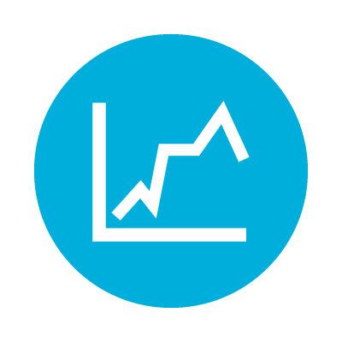
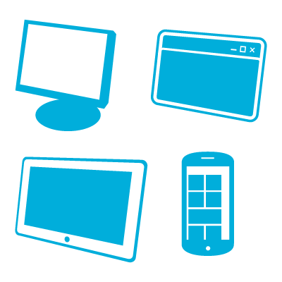















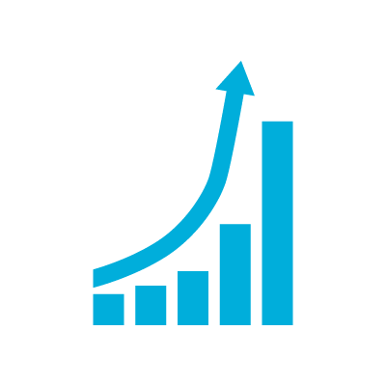


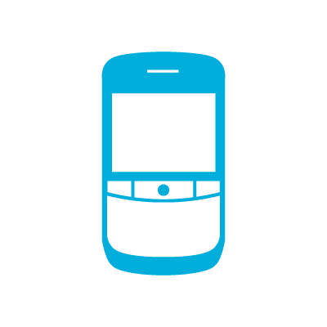




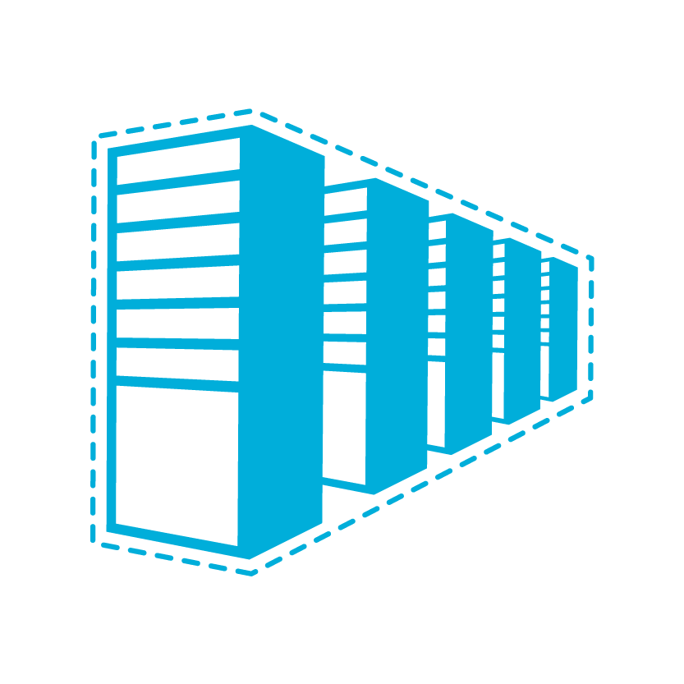

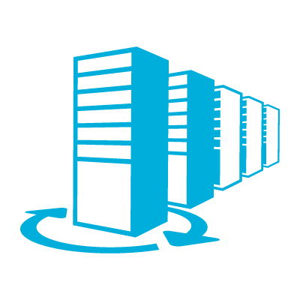

Devices
Social
Software
Growth/Results

Slide 8
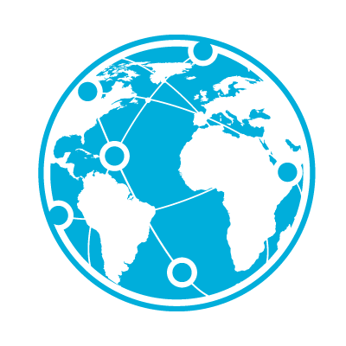
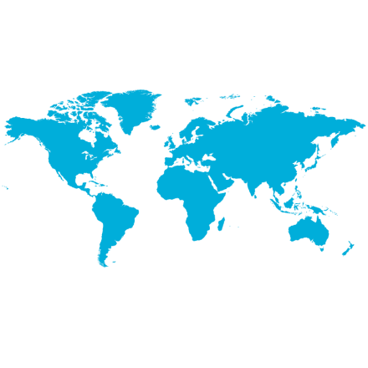
























Questions / Ending
Worldwide
Learning
Office
Money
Cloud
Charts & Graphs
Logo
Time / Date

Slide 9






Agri
Finance
Remaining

Slide 10
General
Strategy
Customers
Service /
Development

Slide 11
Learning
Devices
Growth/Results
Questions / Ending
Social
Cloud
Charts & Graphs
Office

Slide 12
Agri
Finance

